Slide 1
Rule of product

Slide 2
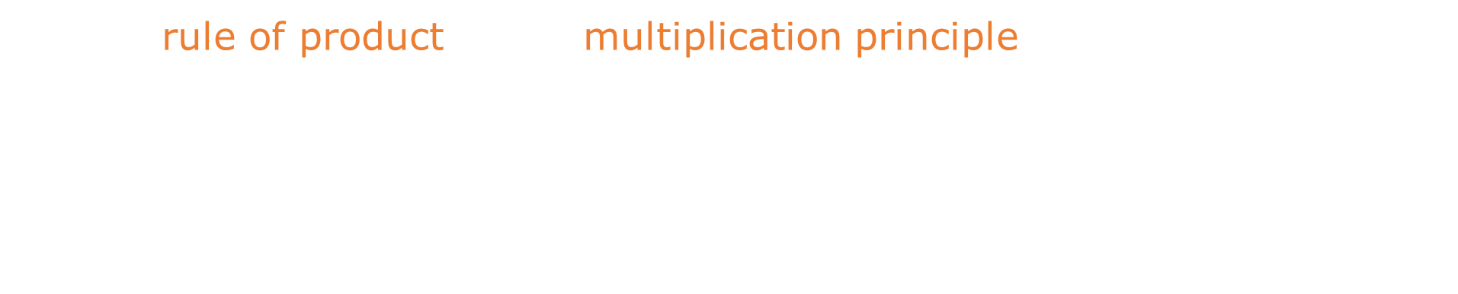
Rule of product
By the rule of product (also: multiplication principle) we call the theorem
stating that:
if a process consists of $n$ steps, and there are $a_{1}$ options (choices) for the
first step, $a_{2}$ options for the second step, $…$, and $a_{n}$ options for
the $n$-th step, then the total number of possible outcomes is:
$$a_{1}⋅a_{2}⋅…⋅a_{n}$$

Slide 3

Rule of product
By the rule of product (also: multiplication principle) we call the theorem
stating that:
if a process consists of $n$ steps, and there are $a_{1}$ options (choices) for the
first step, $a_{2}$ options for the second step, $…$, and $a_{n}$ options for
the $n$-th step, then the total number of possible outcomes is:
$$a_{1}⋅a_{2}⋅…⋅a_{n}$$
Note: In the rule of product, it is important that the number of options
available at each step does not depend on the choices made in the previous
steps. That is: the number $a_{2}$ must remain constant regardless of which
of the $a_{1}$ options is chosen, and so on.

Slide 4
Rule of product
Example 1:

Slide 5
Rule of product
Example 1:
A man getting ready to leave his house can choose from five pairs of pants,
eight shirts and three pairs of shoes. In how many different ways can he
get dressed for going out?

Slide 6

Rule of product
Example 1:
A man getting ready to leave his house can choose from five pairs of pants,
eight shirts and three pairs of shoes. In how many different ways can he
get dressed for going out?
$$Number of ways=5⋅8⋅3=120$$

Slide 7
Rule of product
Example 2:
Until the 1960s, the USA and Canada used a telephone number format
known as 2L-5N, which stood for „2 Letters, 5 numbers”.
This meant that a typical phone number began with two
capital letters followed by five digits.

Slide 8
Rule of product
Example 2:
Until the 1960s, the USA and Canada used a telephone number format
known as 2L-5N, which stood for „2 Letters, 5 numbers”.
This meant that a typical phone number began with two
capital letters followed by five digits.
An example of such a number was: PL-12345, which meant dialing 12345
through the telephone exchange center PLaza. So, the first two letters
usually referred to the name of the local telephone exchange.

Slide 9
Rule of product
Example 2:
Until the 1960s, the USA and Canada used a telephone number format
known as 2L-5N, which stood for „2 Letters, 5 numbers”.
This meant that a typical phone number began with two
capital letters followed by five digits.
An example of such a number was: PL-12345, which meant dialing 12345
through the telephone exchange center PLaza. So, the first two letters
usually referred to the name of the local telephone exchange.
Question: How many different subscribers could there have been at
most during that time?

Slide 10

Rule of product
Example 2:
Until the 1960s, the USA and Canada used a telephone number format
known as 2L-5N, which stood for „2 Letters, 5 numbers”.
This meant that a typical phone number began with two
capital letters followed by five digits.
An example of such a number was: PL-12345, which meant dialing 12345
through the telephone exchange center PLaza. So, the first two letters
usually referred to the name of the local telephone exchange.
Question: How many different subscribers could there have been at
most during that time?
Solution: The first letter could be any of the 26 letters of the English
alphabet A-Z. Regardless of the first, the second letter could also be
any of 26 letters. Each of the five digits could be any of $10$ digits: $0−9$.

Slide 11
Rule of product
Example 2:
Until the 1960s, the USA and Canada used a telephone number format
known as 2L-5N, which stood for „2 Letters, 5 numbers”.
This meant that a typical phone number began with two
capital letters followed by five digits.
An example of such a number was: PL-12345, which meant dialing 12345
through the telephone exchange center PLaza. So, the first two letters
usually referred to the name of the local telephone exchange.
Question: How many different subscribers could there have been at
most during that time?
Solution: The first letter could be any of the 26 letters of the English
alphabet A-Z. Regardless of the first, the second letter could also be
any of 26 letters. Each of the five digits could be any of $10$ digits: $0−9$.
In total: $26⋅26⋅10⋅10⋅10⋅10⋅10={26}^{2}⋅{10}^{5}=67,600,000$

Slide 12

Rule of product
The rule of product is a more general concept that underlies
permutations (including $k$-permutations) and $k$-tuples.

Slide 13
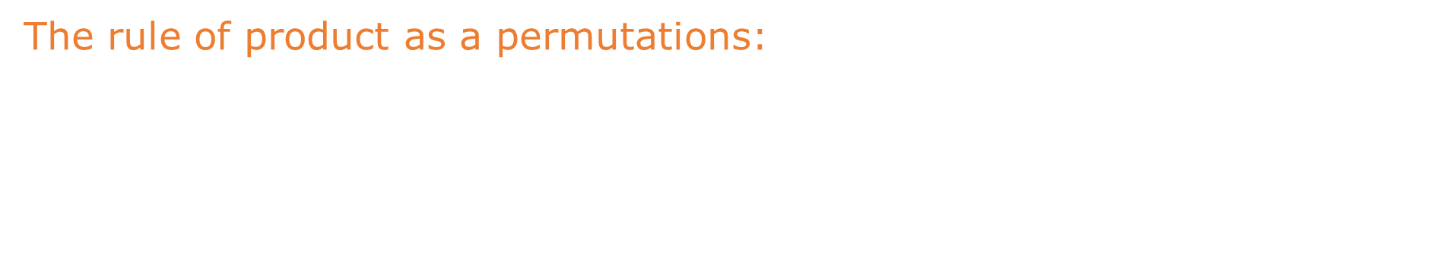
Rule of product
The rule of product is a more general concept that underlies
permutations (including $k$-permutations) and $k$-tuples.
The rule of product as a permutations:
At the ground floor of a building with $7$ floors (including the ground floor)
$6$ people enter the elevator, each intending to get off on a different floor
(it doesn’t matter who gets off where). In how many different ways
can the people be arranged?

Slide 14

Rule of product
The rule of product is a more general concept that underlies
permutations (including $k$-permutations) and $k$-tuples.
The rule of product as a permutations:
At the ground floor of a building with $7$ floors (including the ground floor)
$6$ people enter the elevator, each intending to get off on a different floor
(it doesn’t matter who gets off where). In how many different ways
can the people be arranged?
Solution: all $6$ floors are used. On the first floor any of the $6$ people can
get off. On the second floor, any of the remaining $5$ can get off. On the
third floor, any of the remaining $4$, and so on…

Slide 15
Rule of product
The rule of product is a more general concept that underlies
permutations (including $k$-permutations) and $k$-tuples.
The rule of product as a permutations:
At the ground floor of a building with $7$ floors (including the ground floor)
$6$ people enter the elevator, each intending to get off on a different floor
(it doesn’t matter who gets off where). In how many different ways
can the people be arranged?
Solution: all $6$ floors are used. On the first floor any of the $6$ people can
get off. On the second floor, any of the remaining $5$ can get off. On the
third floor, any of the remaining $4$, and so on…
Total number of possible arrangements: $6⋅5⋅4⋅3⋅2⋅1=6!$ $(720 ways)$

Slide 16
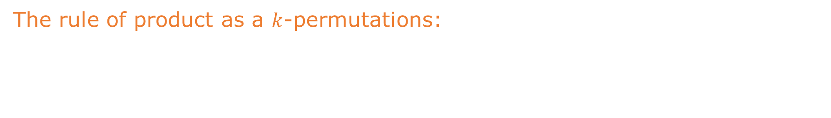
Rule of product
The rule of product is a more general concept that underlies
permutations (including $k$-permutations) and $k$-tuples.
The rule of product as a $k$-permutations:
Into the empty elevator of a building of $7$ floors (including the ground floor),
$3$ people enter on the ground floor, each wanting to get off on a different
floor. In how many ways can they be distributed in the building?

Slide 17
Rule of product
The rule of product is a more general concept that underlies
permutations (including $k$-permutations) and $k$-tuples.
The rule of product as a $k$-permutations:
Into the empty elevator of a building of $7$ floors (including the ground floor),
$3$ people enter on the ground floor, each wanting to get off on a different
floor. In how many ways can they be distributed in the building?
The first person can go out on one of the six floors,
the second on one of the remaining five floors,
the third on one of the remaining four floors.

Slide 18

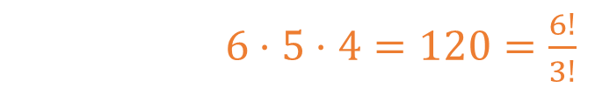
Rule of product
The rule of product is a more general concept that underlies
permutations (including $k$-permutations) and $k$-tuples.
The rule of product as a $k$-permutations:
Into the empty elevator of a building of $7$ floors (including the ground floor),
$3$ people enter on the ground floor, each wanting to get off on a different
floor. In how many ways can they be distributed in the building?
The first person can go out on one of the six floors,
the second on one of the remaining five floors,
the third on one of the remaining four floors.
In total: $6⋅5⋅4=120=\frac{6!}{3!}$

Slide 19
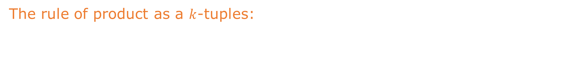
Rule of product
The rule of product is a more general concept that underlies
permutations (including $k$-permutations) and $k$-tuples.
The rule of product as a $k$-tuples:
Into the empty elevator of a building of $7$ floors (including the ground floor),
$5$ people enter on the ground floor. We know nothing about their intentions
of getting off. In how many ways can they be distributed in the building?

Slide 20
Rule of product
The rule of product is a more general concept that underlies
permutations (including $k$-permutations) and $k$-tuples.
The rule of product as a $k$-tuples:
Into the empty elevator of a building of $7$ floors (including the ground floor),
$5$ people enter on the ground floor. We know nothing about their intentions
of getting off. In how many ways can they be distributed in the building?
Solution: the first person can go to one of the six floors,
the second person can go to one of the six floors, ....

Slide 21
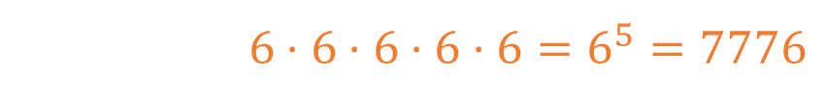
Rule of product
The rule of product is a more general concept that underlies
permutations (including $k$-permutations) and $k$-tuples.
The rule of product as a $k$-tuples:
Into the empty elevator of a building of $7$ floors (including the ground floor),
$5$ people enter on the ground floor. We know nothing about their intentions
of getting off. In how many ways can they be distributed in the building?
Solution: the first person can go to one of the six floors,
the second person can go to one of the six floors, ....
In total: $6⋅6⋅6⋅6⋅6=6^{5}=7776$

Slide 22

Rule of product
The rule of product is a more general comcept that underlies
permutations (including $k$-permutations) and $k$-tuples.
The rule of product as a $k$-tuples:
Into the empty elevator of a building of $7$ floors (including the ground floor),
$5$ people enter on the ground floor. We know nothing about their intentions
of getting off. In how many ways can they be distributed in the building?
Solution: the first person can go to one of the six floors,
the second person can go to one of the six floors, ....
In total: $6⋅6⋅6⋅6⋅6=6^{5}=7776$
That is, as many as there are five-tuples (with repetitions) of the
six-element set (=five-letter words consisting each solely of the
letters abcdef).

Slide 23
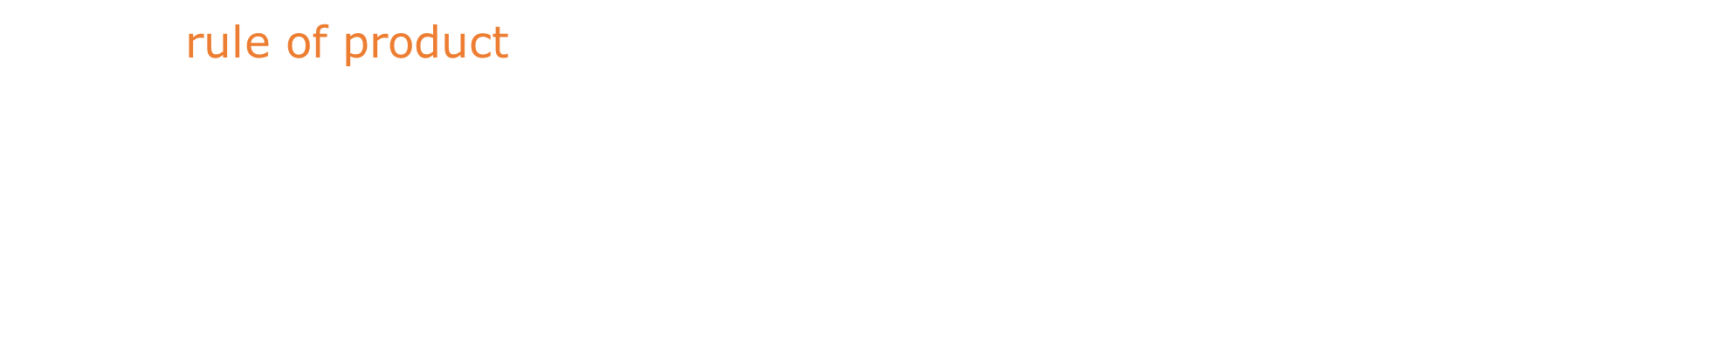
Rule of product
So the rule of product says that if the first bag (or set) contains $n_{1}$ objects,
the second bag contains $n_{2}$ objects, …, and the $k$-th bag contains $n_{k}$
objects, then if we randomly select one object from each bag, the total
number of different possible outcomes (i.e., final states after all selections)
is:
$$n_{1}⋅n_{2}⋅…⋅n_{k}$$

Slide 24
Rule of product
So the rule of product says that if the first bag (or set) contains $n_{1}$ objects,
the second bag contains $n_{2}$ objects, …, and the $k$-th bag contains $n_{k}$
objects, then if we randomly select one object from each bag, the total
number of different possible outcomes (i.e., final states after all selections)
is:
$$n_{1}⋅n_{2}⋅…⋅n_{k}$$
The rule of product is closely related to the logical connector "and"
We read that a man has choices:
one of five pairs of pants, and one of eight shirts, and one of three
pairs of shoes. Each occurence of the word and corresponds to a
multiplication operation.

